Slide 1
Image Inpainting with External-internal Learning and Monochromic Bottleneck
Tengfei Wang* Hao Ouyang* Qifeng Chen
The Hong Kong University of Science and Technology
CVPR 2021
Notes:
We present Image Inpainting with External-internal Learning and Monochromic Bottleneck, a novel method for image inpainting

Slide 2
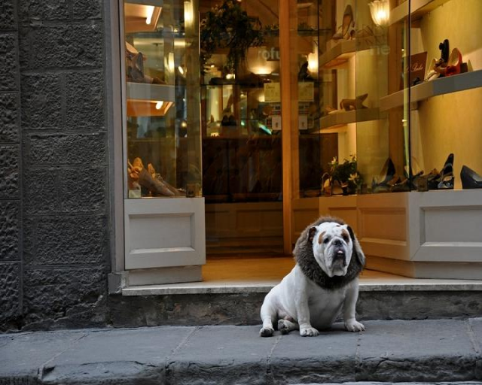
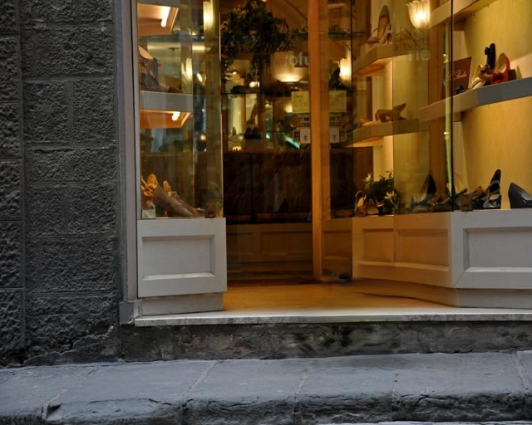
What is image inpainting?
Filling missing regions in an image with realistic and consistent content
objects removal
old photos restoration
Notes:
Image inpainting is to complete the missing regions of a given image with visually realistic and semantically consistent content. It can be used for various applications, including undesired object removal, old photo restoration and image editing. While clear progress has shown in recent years, inpainting models still suffer from abrupt color artifacts, especially when the missing regions are large. This work will analyze the weaknesses of state-of-the-art inpainting approaches and present a novel framework to improve existing inpainting methods.

Slide 3
Are previous methods good enough?
inconsistent color
Input
GC
Learning from diverse images
Input
EC
Notes:
The deep learning based inpainting approaches have shown good performance by learning on large-scale datasets.
However, inpainting networks trained on large datasets usually suffer from the “color bleeding” artifacts. Here are inpainting results by two popular learning-based methods. The colors in the inpainted area show discrepancy from nonmissing regions. This distribution gap indicates the possibility of improving inpainting quality by eliminating outliner colors in the missing region. Hence, we are motivated to improve the color consistency by learning only from the internal color distribution of the non-missing parts.

Slide 4
Are previous methods good enough?
inconsistent color
consistent color
Input
GC
Ours (re-colored)
Learning from diverse images
Learning from single image
Input
EC
Ours (re-colored)
Notes:
To show the visual quality improvement brought by the internal colorization, we apply our method to re-colorize these two images. By strengthening
the impact of internal color statistics in the single image, the abrupt colors can be eliminated.

Slide 5
How to focus on internal distribution?
Internal-learning ?
input
NN
output
Optimize on single image
Notes:
However, learning inpainting only from internal statistics is inappropriate since external information is significant for content aware image inpainting. A feasible solution is to set an intermediate bottleneck as a bridge between the external and internal learning.

Slide 6
How to focus on internal distribution?
external-internal learning
Internal-learning ?
input
NN-1
bottleneck
Training on large datasets
(external knowledge)
input
NN
output
bottleneck
NN-2
output
Optimize on single image
learning on single image
(internal distribution)
Notes:
we choose monochrome images as the intermediate output, as it leads to another advantage. by reducing the output dimension from R3 to R1, the complexity of training is alleviated. We expect that models trained with monochromic bottlenecks can reconstruct higher-fidelity structures than original ones.

Slide 7
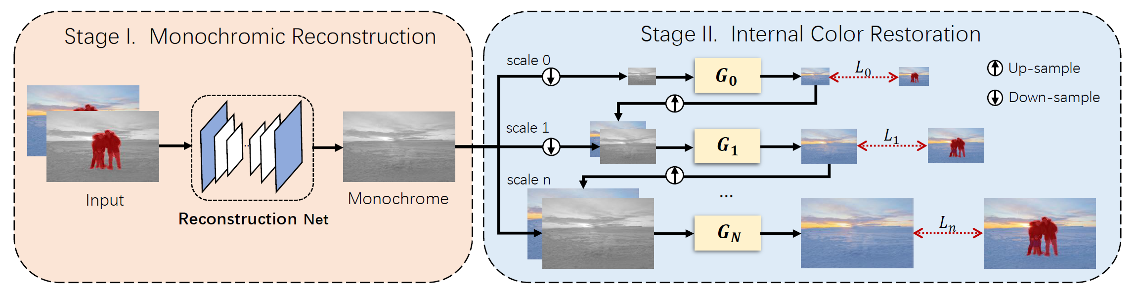
Method
This method can be easily applied to improve different inpainting baselines.
Notes:
This is the overall architecture of our method. It first externally learns to reconstruct structures in the monochromic space via
training on large datasets. In the second stage, the input of the colorization network is the
completed monochromic bottleneck from the first stage, while the goal is to restore colors consistent with the distribution of non-missing regions. The proposed method is orthogonal to existing inpainting methods, since it can adopt different inpainting baselines as the reconstruction net.

Slide 8
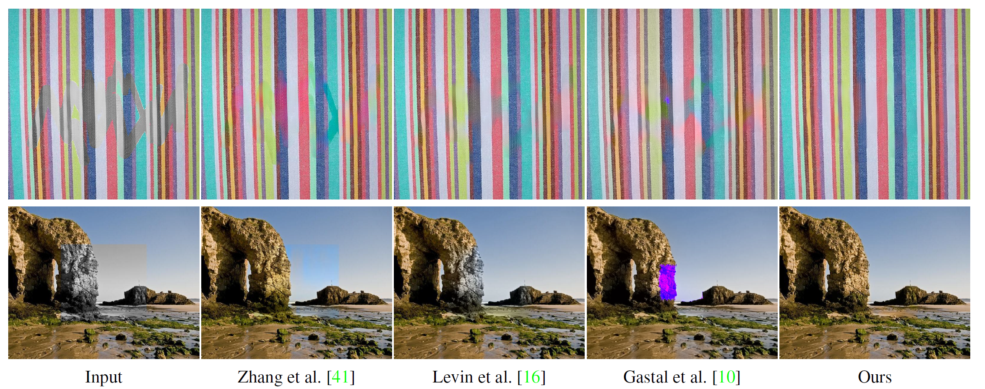
Compare with previous colorization methods
Notes:
For the colorization, We also tested with several guided colorization methods.
However, they either magnify the inaccuracy in the monochrome and introduces color bleeding or fail in propagation when the mask region is large.
We analyze the special features of our cases that are different from most of previous colorization settings. Unlike traditional sparse guidance such as color stroke
and color palette, the guidance in our case is multiple accurate one-to-one mappings from monochrome to RGB. Since non-missing regions usually consist of
an ample amount of pixels, the correspondence is extremely dense and covers most of patterns. And Structures in the missing region and the
non-missing region are often highly correlated.

Slide 9
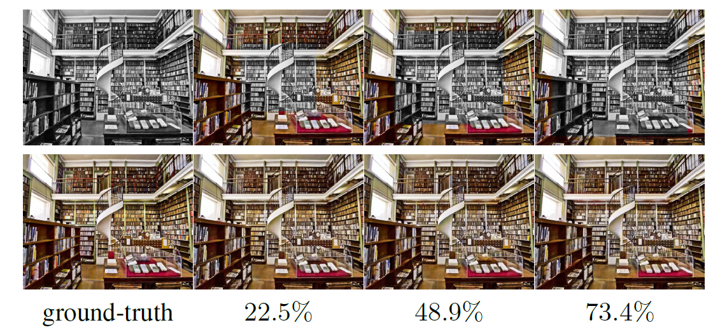
Feasibility of our colorization method
Notes:
One key factor that may affect the performance of our internal
colorization method is the number of known pixel
correspondences. we increase the mask and observe even in challenging
case where 73:4% pixels are missing

Slide 10
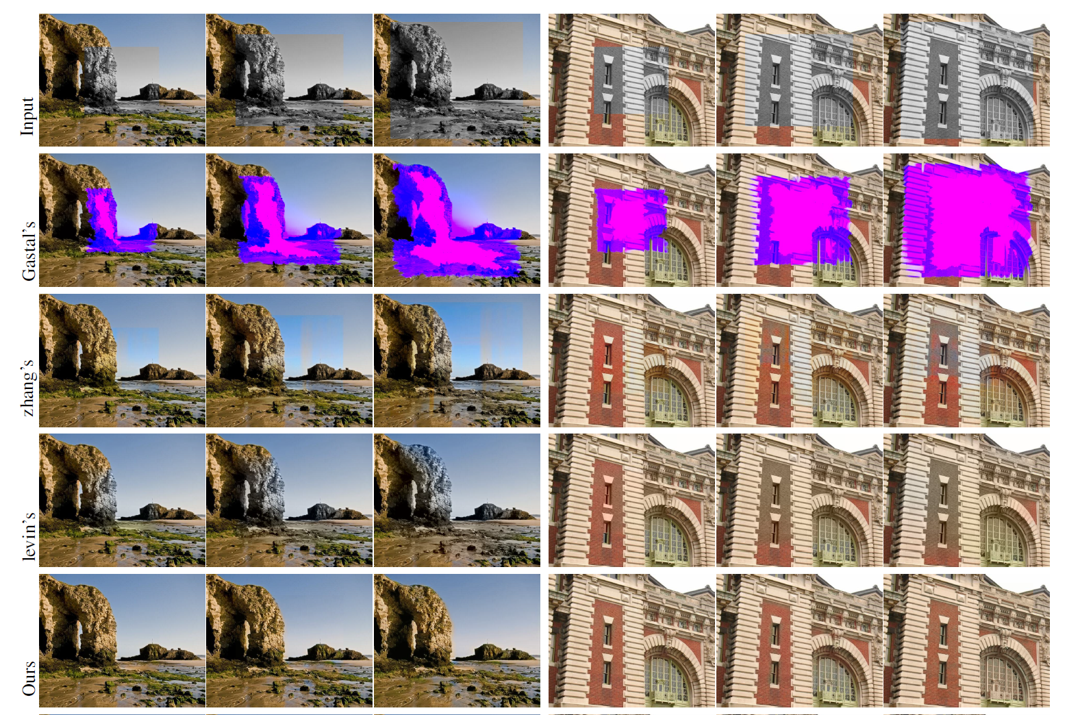
Notes:
the model still colorizes Ihole in a harmonized style with Inhole without
noticeable artifacts.
The feasibility is also validated on images rom different categories,

Slide 11
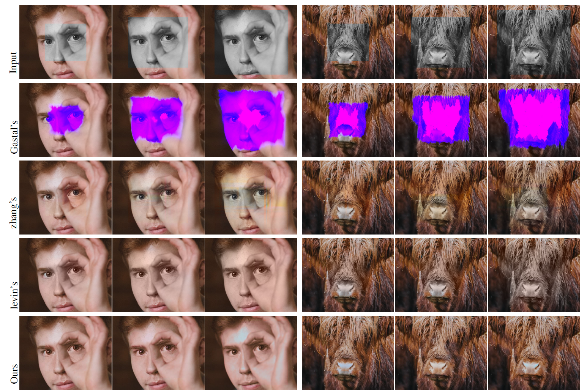
Notes:
including natural scenery, buildings,
human faces, and animals.

Slide 12
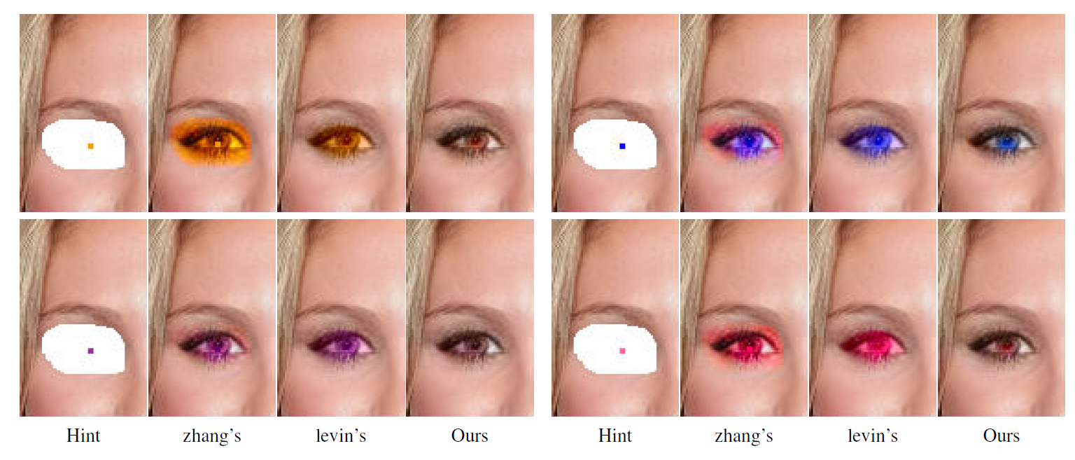
Notes:
And user-guided colorization

Slide 13
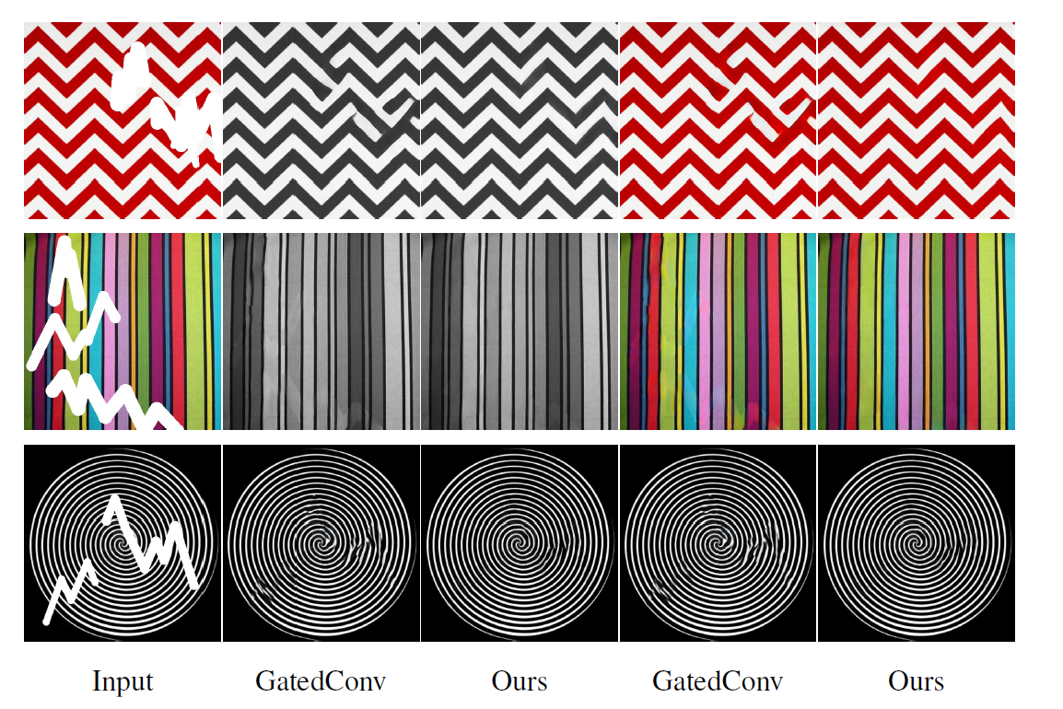
Reconstruction quality
Notes:
On top of colors, structures and shapes completed by our method are also sharper than previous methods. Intuitively, it is easier to learn the reconstruction
on monochrome than RGB. the model trained in this way is able to capture the essence of structures and complete correct shapes.
It indicates that ignoring color distraction can alleviate the learning complexity and facilitates structure reconstruction.

Slide 14
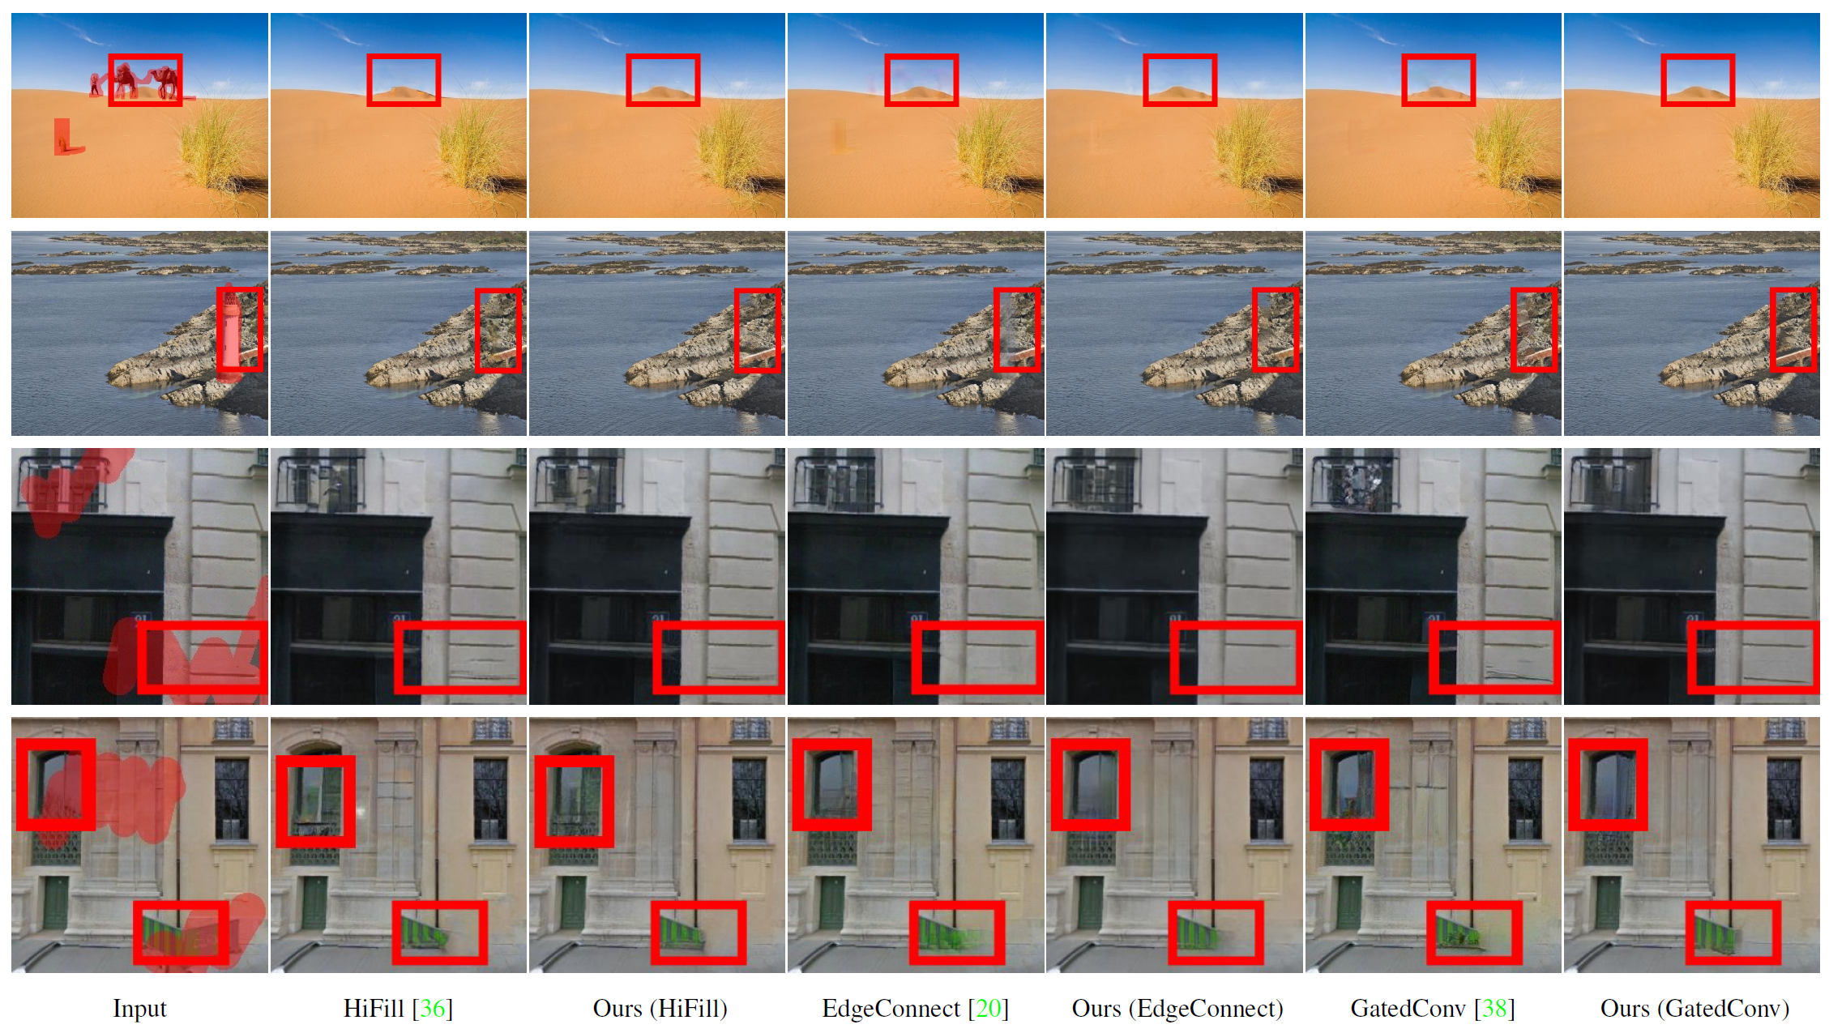
Notes:
The method is applied to different baseline models. This indicates that the proposed approach
is not limited to one specific inpainting architecture but can
be easily generalized to improve existing models.

Slide 15
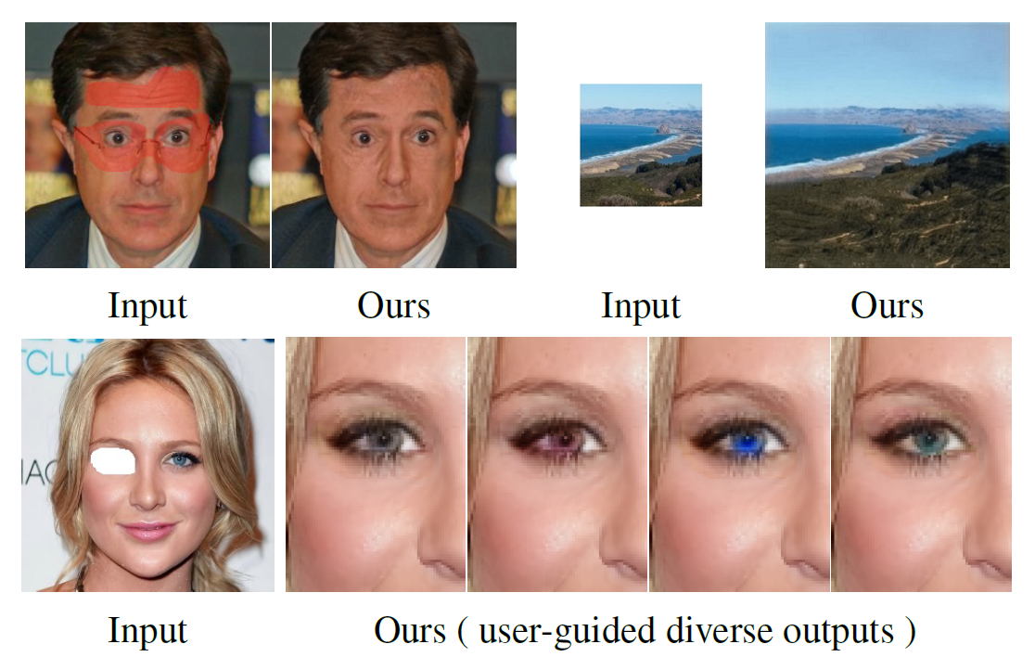
Applications
Notes:
the proposed method can be applied to image editing, extrapolation, and userguided inpainting. We demonstrate one user-guided inpainting example,
where users can control the color of generated content by giving few color hints interactively. We utilize one extra
color point as guidance to inpaint eyes with different colors.

Slide 16
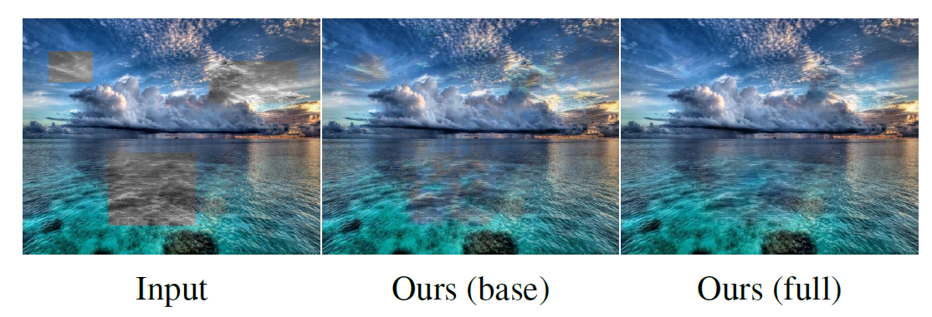
Ablation study
Notes:
We conduct ablation study to figure out how the progressive
restoration strategy contributes to the internal colorization.
It shows that without the progressive scheme,
our model focuses only on local color mappings and generates
obvious artifacts and hard boundaries.

Slide 17
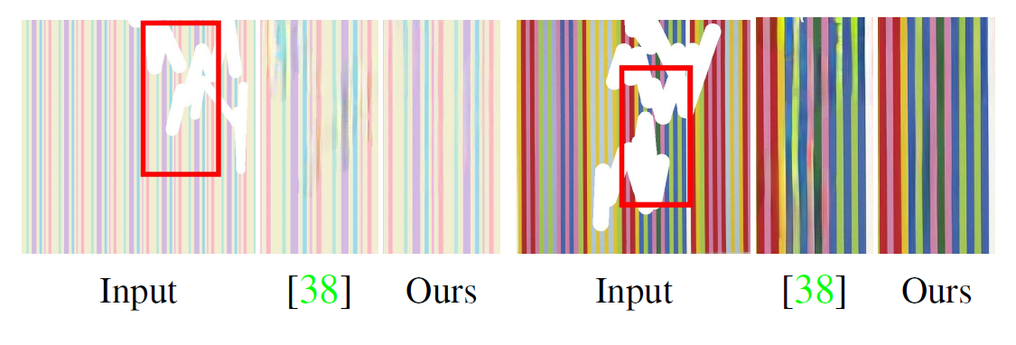
Cross-dataset evaluation
Notes:
We conduct a cross-dataset evaluation to show the generalization ability
gain brought by the monochromic bottleneck. our model generates sharper lines and
more consistent colors with seamless boundary. By learning
to reconstruct structures in the monochromic space, the gap
between different types of datasets is narrowed.

Slide 18
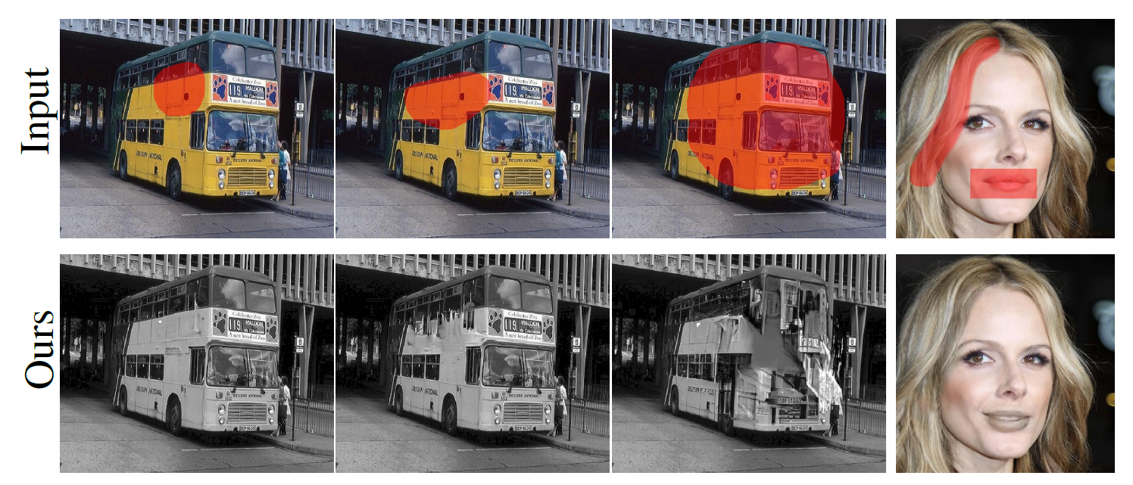
Limitation
Failure cases
Inference speed
Notes:
Here are two failure cases of the proposed inpainting method. In the first example, our method fails to reconstruct
a partially-masked object when the mask is extremely large, since the structures of these categories are highly complex
In the second example, our model incorrectly colorizes the mouth due to the lack of colorization hints.

Slide 19
Limitation
Failure cases
Inference speed
Notes:
Another limitation of our method is the inference speed. Since an extra stage is
needed for colorization, our method is slower than stateof-the-art approaches.
we hope the method can be further accelerated and extended to other low-level vision tasks in the future.

Slide 20
Thank you! project page: https://tengfei-wang.github.io/EII/index.html
Notes:
Thank you for your attention. Please visit our webpage for code and paper.

